Slide 1
Super Resolution with Convolutional Neural Network
Yihao Lin and Tasbir Rahman

Slide 2
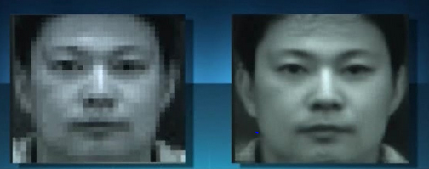

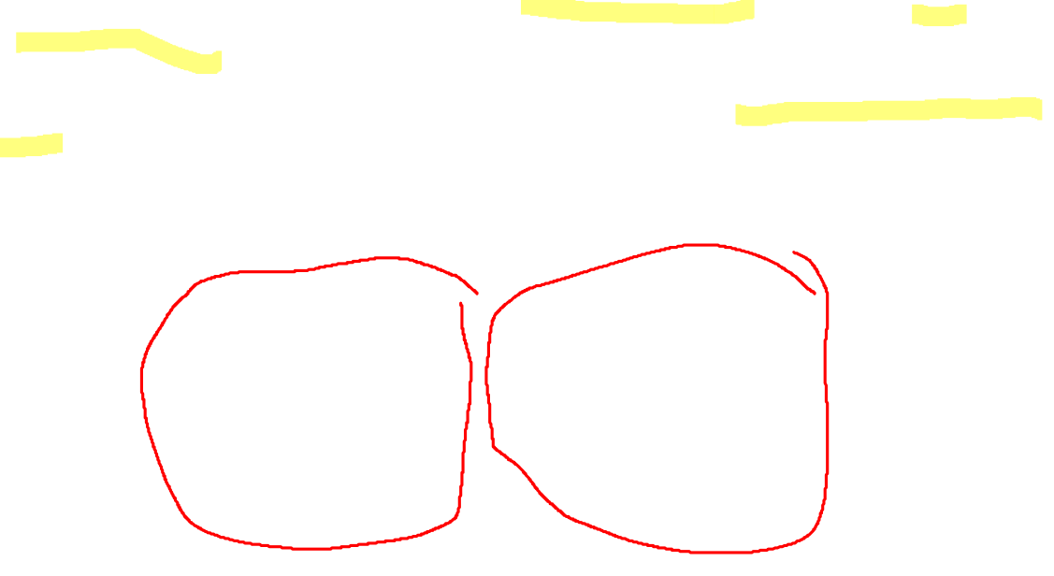
What is Super Resolution?
Super resolution is the process of recovering a High Resolution image from a given Low Resolution image.
Conventional methods of scaling up images to a higher size often fail to recover detail that was lost. Instead the upscaled image either looks pixelated or blurry
The goal of super resolution imagery is to recover, or make a guess at recovering this loss detail

Slide 3

What we have done so far?
Our solution is an implementation of the model described in the paper “Image Super-Resolution Using Deep Convolutional Networks” by Dong et. al. Which uses a fully convolutional neural network
First images are resized to their desired size using bicubic interpolation.
Images are then converted to YCbCr color space. The network takes the Y channel, which measures luminosity, as input and outputs the SR image’s Y channel. The other two channels are upscaled with bicubic interpolation

Slide 4
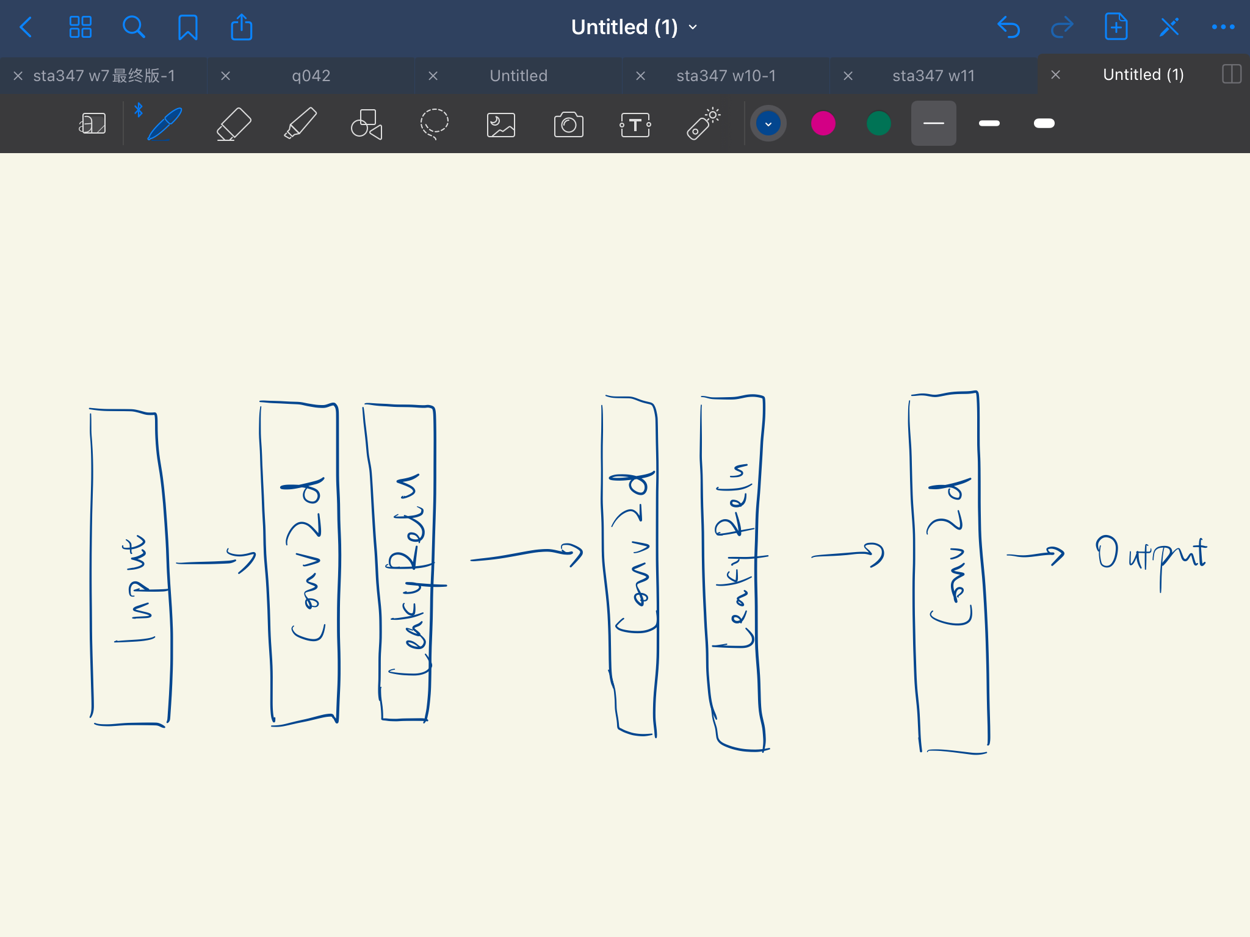
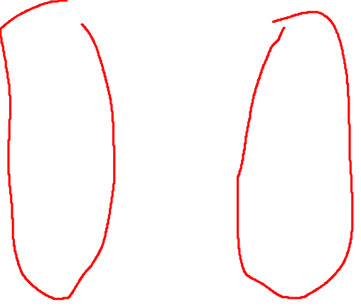
Convolutional neural network structure

Slide 5
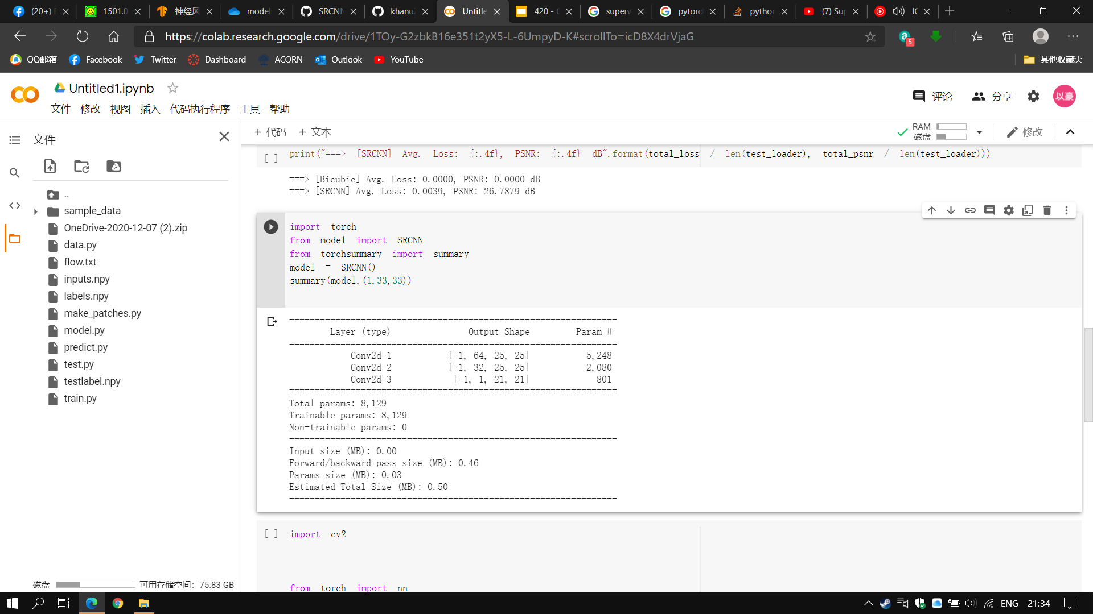


Slide 6

Why Convolutional Neural Network?
There are more recent better performing neural network models for SR. Namely, SRResNet which makes use of Residual connections and SRGAN which makes use of a Generative Adversarial Network.
We originally wanted to implement ESRGAN, an improvement upon SRGAN. However upon further research that GANs and ResNets have much more complicated structures. SRResnet, SRGAN, and ESRGAN all have much more trainable parameters than SRCNN. The result of this is that training takes much longer to converge. In fact, on the github repo for ESRGAN, it was stated that training took a full week to get decent results. Not only that, but massive datasets are required to prevent overfitting
SRCNN has comparatively fewer trainable parameters. This means we can use a smaller datasets and have our training converge faster.

Slide 7

Training process
We followed the paper’s method for training.
Take each image in the training set
Divide into 33 x 33 patches
Take the Y channel
Downscale the image patch by a scaling factor of 3 then upscale to get training input
Center crop 21x21 area of the patch to get label
The paper took the center 21x21 area to prevent border effects during training

Slide 8

Training set
The patch splitting process allowed us to get a dataset of over 20,000 from a set of 91 images. These 91 images are the same as the ones from the paper
We used 90 percent of these patches for training, and 10 percent for validation.
We used 2000 epochs. The process took about 10 hours on a GTX 2060 SUPER. We saved the weights every 50 epochs.
We used a batch size of 128. We tried different batch sizes and found 128 to be the fastest for completing an epoch.
Our learning rate was 0.0001 for each layer except for the final one where it is 0.00001 as said in the paper

Slide 9

Differences
We used PyTorch instead of MATLAB. This is mostly because we have more knowledge in Python and Pytorch than MATLAB
We used Adam instead of Stochastic Gradient Descent. Adam often converges faster and performs better than Stochastic Gradient Descent. It changes the learning rate as time goes on instead of keeping it constant like with SGD. Since we don’t have super high end GPU’s nor a lot of time this seemed to be an appropriate choice.
We also let PyTorch handle how weights were initialized instead of following exactly how the paper does it.

Slide 10

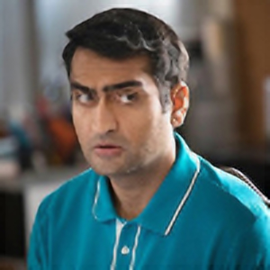

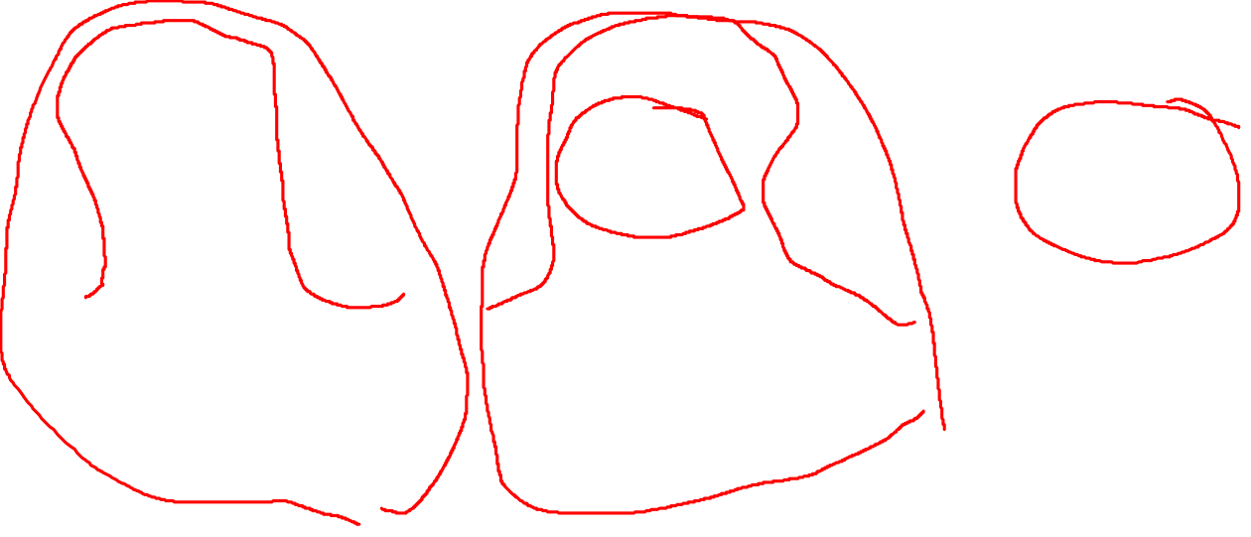
Some Results (BICUBIC THEN PREDICTION THEN GROUND TRUTH) Struggles to fill in detail

Slide 11


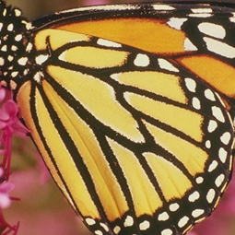
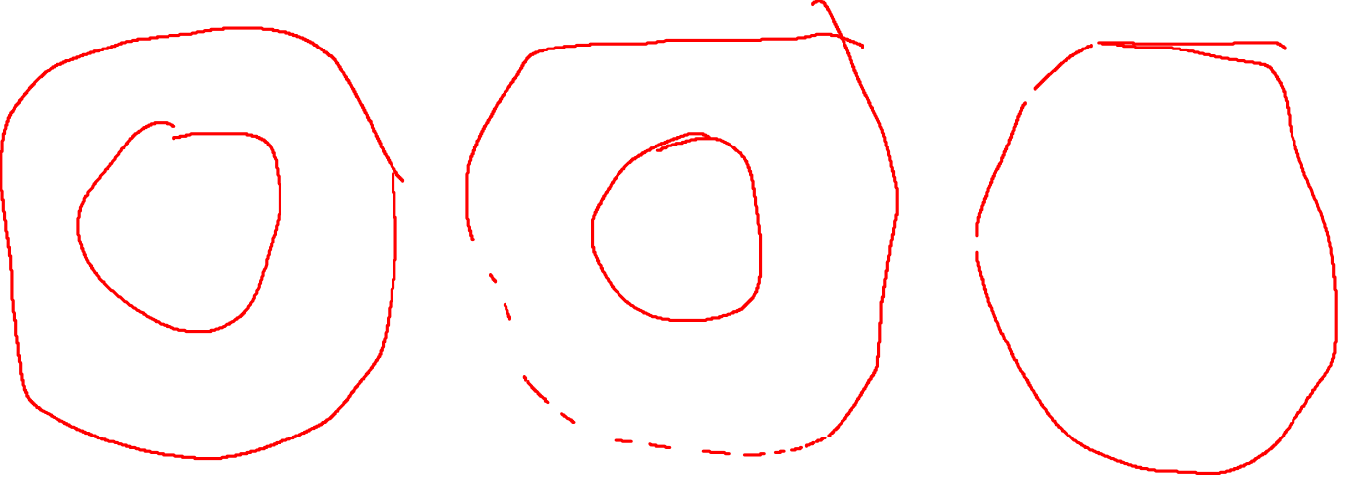
Some Results (BICUBIC THEN PREDICTION THEN GROUND TRUTH) Anti Aliasing

Slide 12
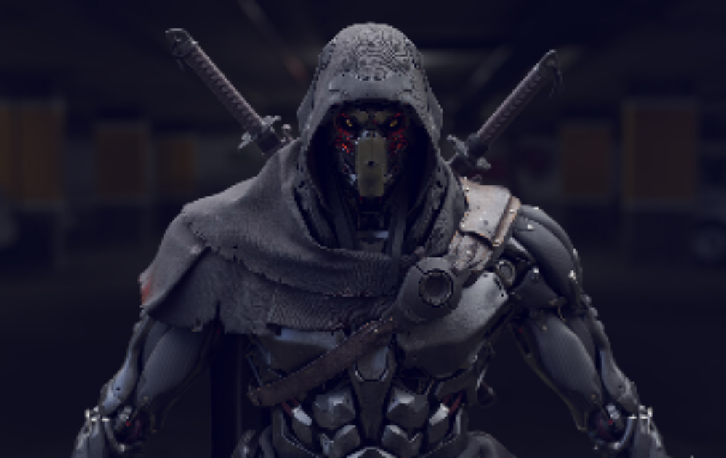
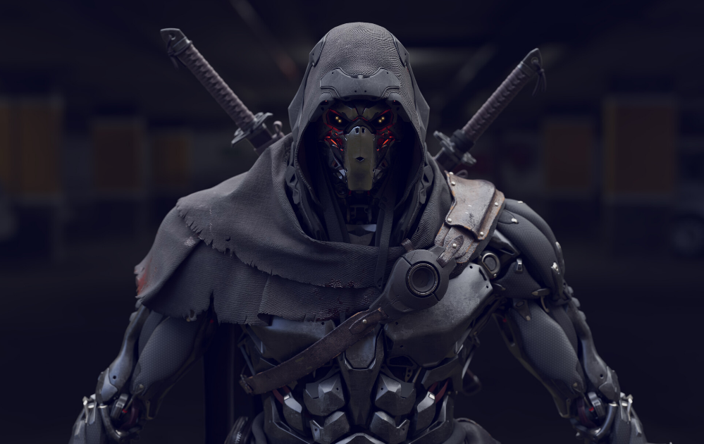

bicubic
Ground Truth
prediction

Slide 13




GOOD WITH PIXEL ART

Slide 14
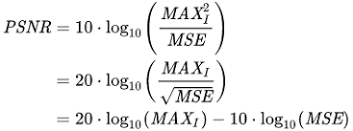
Performance analysis
Peak signal-to-noice ratio(PSNR):
ratio between the maximum possible power of a signal and the power of corrupting noise that affects the fidelity of its representation, expressed in log scale decibels, higher decibels means higher quality of reconstructed images.
MAX here stands for the maximum possible pixel value of the image. Normally it is 255, but since we normalized all pixel values to (0,1), we used MAX of 1.

Slide 15
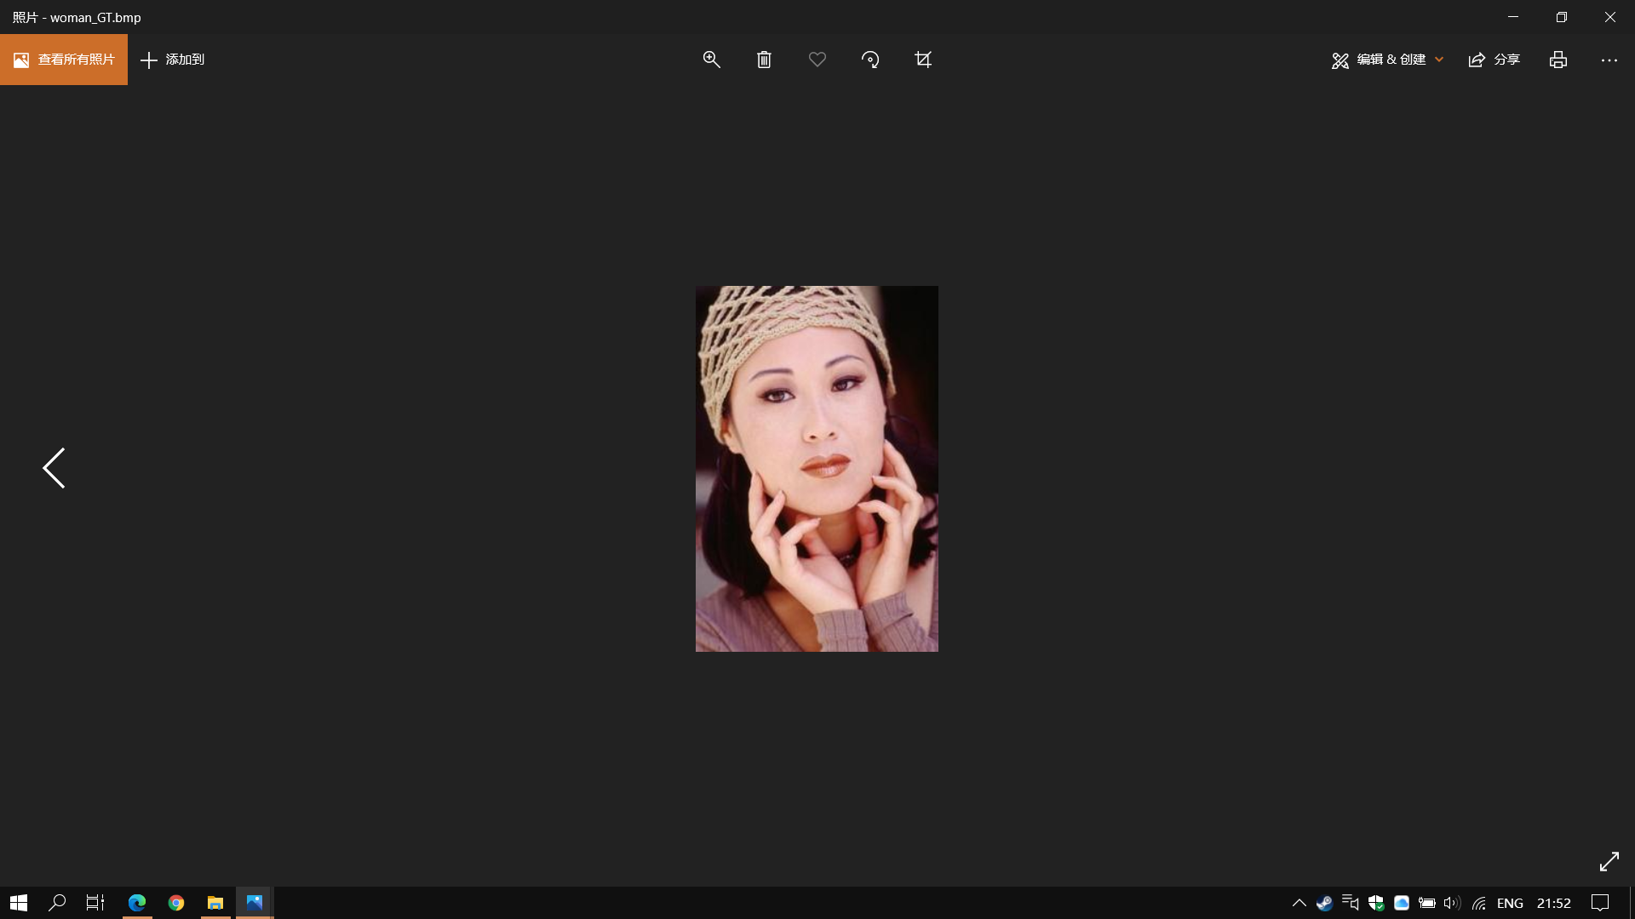
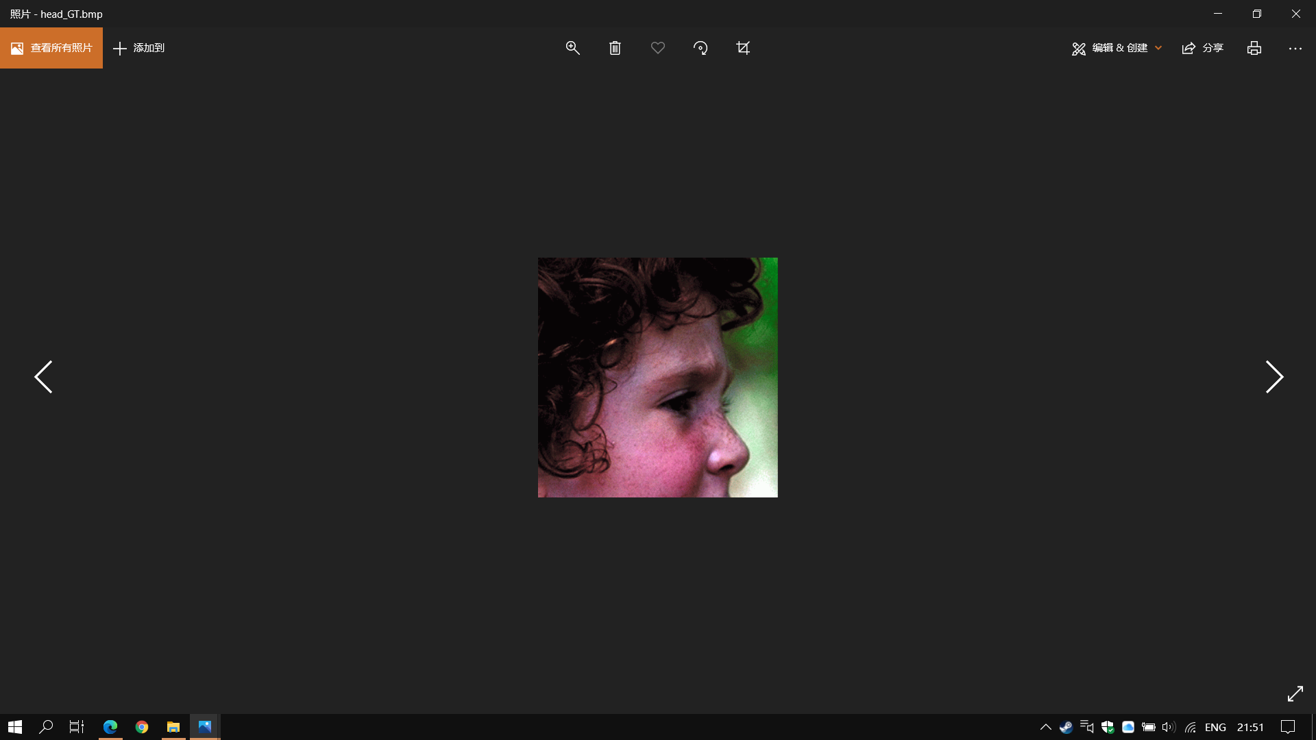

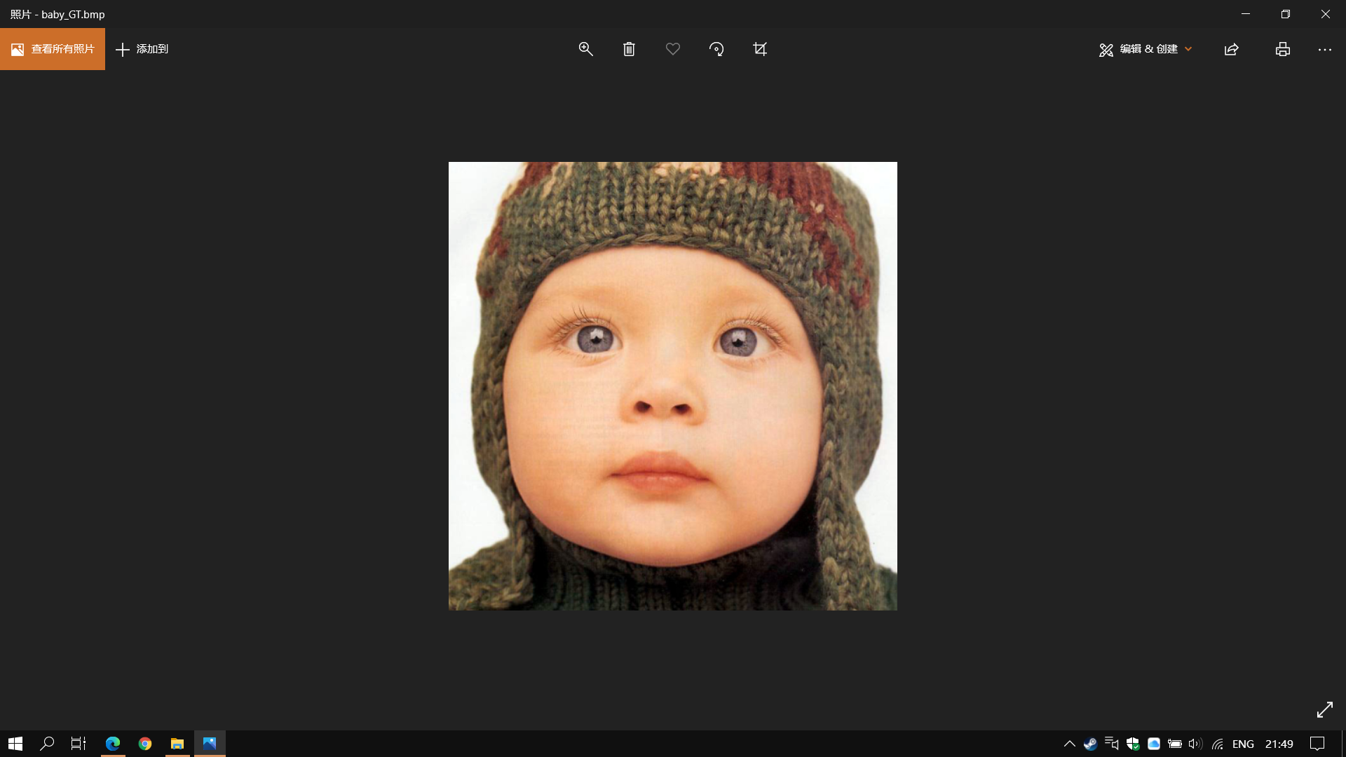


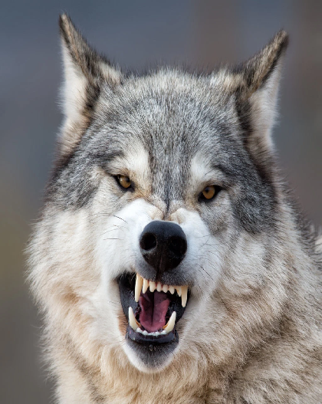


Test set
head_GT
butterfly_GT
woman_GT
bird_GT
baby_GT
ninja
dinesh
Wolf
kaladin

Slide 16
Performance analysis
Image | Bicubic Interpolation | CNN prediction
baby_GT | 27.9642dB | 29.6629dB
bird_GT | 19.4617dB | 24.8802dB
butterfly_GT | 27.5094 | 26.5611
head_GT | 27.4480 | 26.9846
woman_GT | 20.1777 | 21.8148
dinesh | 40.9340 | 42.1107
kaladin | 29.8210 | 30.8748
ninja | 46.7002 | 46.7944
Wolf | 37.4805 | 37.4118
avg prediction PSNR: 31.8995
avg bicubic PSNR: 30.8363

Slide 17
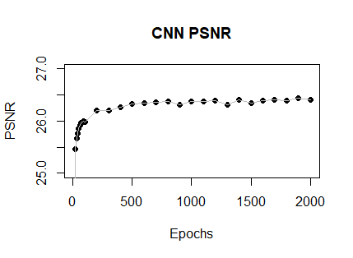
Performance analysis
This result is obtained by averaging over hundreds of patches
Since PSNR is very dataset-dependent, it is more useful to look at image-specific comparisons. However we can still see that PSNR increase becomes minimal with the increase of epochs.

Slide 18
Disclaimer
It seems PSNR is not necessarily indicative of SR Quality
The Butterfly’s prediction looks better than the bicubic interpolation but it has a lower PSNR
It seems that predictions change overall brightness of the image. This likely results in a higher MSE which results in a lower PSNR

Slide 19
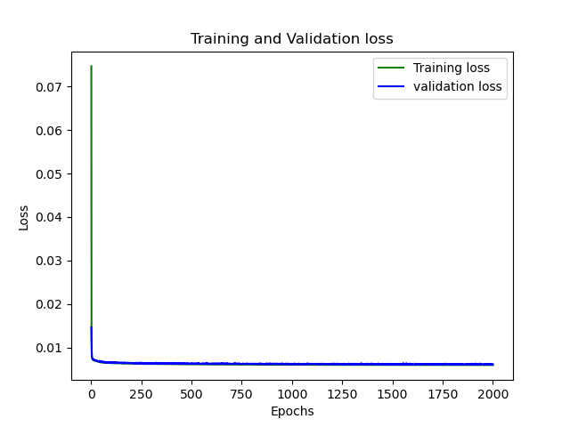
Convergence

Slide 20
Challenges faced
The main challenge we faced were performance related. Although both of us have gaming computers, our video cards are not top of the line. So we had to pick a solution that allowed us to yield acceptable results within a reasonable amount of time.
We also for a while had PSNR values that implied our network was performing poorly compared to bicubic interpolation. This was hard to reconcile with the fact that although results weren’t perfect for our network, they DID look better. It turned out that PSNR is very dependent on the dataset, and we do have similar or greater image-specific PSNR comparing to Bicubic.
Figuring out the exact logistics of how predictions were made was also difficult. It took a thorough reading of not only the paper but also the source code. This was made more difficult by the code being in MATLAB. So far the network outputs an image slightly smaller than the actual scale factor because no padding is used for the convolutions. We opted to just copy the SR part into the center of the Bicubic image.

Slide 21
What’s next?
SRGAN makes use of a loss function that uses the convolution layers of a pretrained classifier (VGG19) instead of Mean Square Error (MSE). This classifier measures “perceptual loss”. Our novel idea is to use this same classifier as a loss function for our network. We believe this will improve the performance of the network while still retaining the simplicity of the structure.
The paper made no mention of why they used bicubic interpolation to preprocess input images during training and predicting. We want to try using the other two methods of interpolation, namely nearest neighbour and bilinear to see what kind of impact it will have on the performance of the network
We might switch to Colab to train our networks instead of our own machines. We found training time to be less than the allowed amount of 12 hours on Colab

